Slide 1
Cornerstone City Church Peninsula Plus Community Hoo Are Ya 18-06-2023

Slide 2
Our God Saves
CCLI Song # 4972837
Brenton Brown | Paul Baloche
© 2007 Integrity's Hosanna! Music (Admin. by Integrity Music Ltd)
Leadworship Songs (Admin. by Integrity Music Ltd)
Thankyou Music (Admin. by Integrity Music Ltd)
For use solely with the SongSelect® Terms of Use. All rights reserved. www.ccli.com
CCLI Licence No. 33265

Slide 3
1/3
In the name of the Father
In the name of the Son
In the name of the Spirit,
Lord we come
We're gather'd together,
To lift up Your name
To call on our Savior to fall on Your grace

Slide 4
2/3
Hear the joyful sound of our offering
As Your saints bow down
As Your people sing
We will rise with You lifted on Your wings
And the world will see that

Slide 5
3/3
Our God saves our God saves
There is hope in Your name
Mourning turns to songs of praise
Our God saves our God saves

Slide 6


Slide 7
House Of The Lord
CCLI Song # 7168995
© 2020 Phil Wickham MusicSimply Global SongsBe Essential SongsCashagamble Jet Music
For use solely with the SongSelect® Terms of Use. All rights reserved. www.ccli.com
Note: Reproduction of this sheet music requires a CCLI Music Reproduction Licence. Please report all copies.
CCLI Licence No. 33265

Slide 8
1/5
We worship the God who was
We worship the God who is
We worship the God who evermore will be
He opened the prison doors
He parted the raging sea
My God He holds the victory yeah

Slide 9
2/5
There’s joy in the house of the Lord
There’s joy in the house of the Lord today
And we won’t be quiet
We shout out Your praise

Slide 10
3/5
There’s joy in the house of the Lord
Our God is surely in this place
And we won’t be quiet
We shout out Your praise

Slide 11
4/5
We sing to the God who heals
We sing to the God who saves
We sing to the God who always makes a way
'Cause He hung up on that cross
Then He rose up from that grave
My God’s still rolling stones away

Slide 12
5/5
We were the beggars
Now we’re royalty
We were the prisoners
Now we’re running free
We are forgiven accepted
Redeemed by His grace
Let the house of the Lord sing praise

Slide 14
Good Good Father
CCLI Song # 7036612
Anthony Brown | Pat Barrett
© 2014 Capitol CMG Paragon (Admin. by Capitol CMG Publishing)
Common Hymnal Digital (Admin. by Capitol CMG Publishing)
Housefires Sounds (Admin. by Capitol CMG Publishing)
Rising Springs Music (Admin. by Capitol CMG Publishing)
Tony Brown Publishing Designee (Admin. by Capitol CMG Publishing)
Vamos Publishing (Admin. by Capitol CMG Publishing)
worshiptogether.com songs (Admin. by Capitol CMG Publishing)
For use solely with the SongSelect® Terms of Use. All rights reserved. www.ccli.com
CCLI Licence No. 33265

Slide 15
1/5
I've heard a thousand stories
Of what they think You’re like
But I've heard the tender whisper
Of love in the dead of night
You tell me that You’re pleased
And that I'm never alone

Slide 16
2/5
You're a Good Good Father
It's who You are
It's who You are
It's who You are
And I'm loved by You
It's who I am
It's who I am
It's who I am

Slide 17
3/5
I've seen many searching for answers
Far and wide
But I know we're all searching for answers
Only You provide
Because You know just what we need
Before we say a word

Slide 18
4/5
You are perfect in all of Your ways
You are perfect in all of Your ways
You are perfect in all of Your ways to us

Slide 19
5/5
Love so undeniable I can hardly speak
Peace so unexplainable I can hardly think
As You call me deeper still
As You call me deeper still
As You call me deeper still
Into love love love

Slide 21


Slide 22
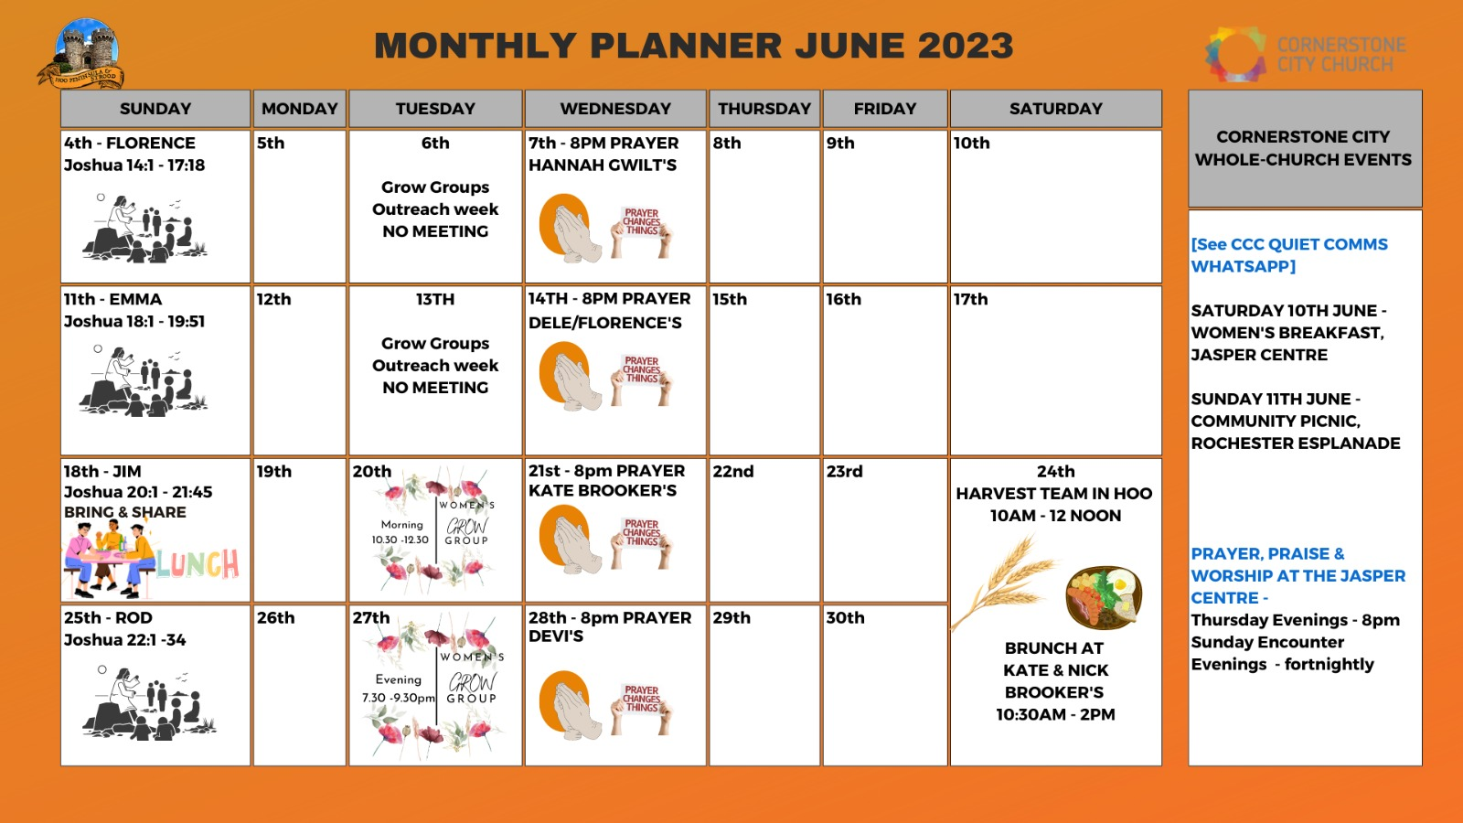

Slide 23


Slide 24
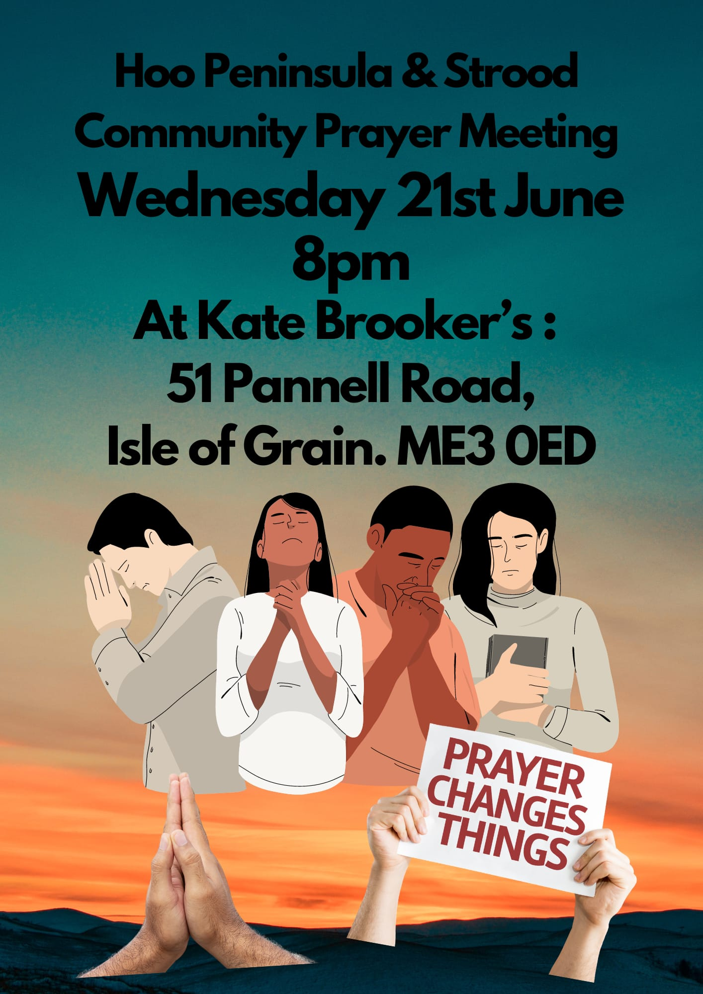

Slide 25


Slide 26


Slide 27


Slide 28


Slide 29


Slide 30


Slide 31


Slide 32


Slide 33


